Slide 1


TITLE OF THE PROJECT
Department of Computer Science and Engineering Interdisciplinary Project
Social Media App: Chime
Project Student: Guide:
EARLADINNE SAI DHEERAJ Dr.V.Nirmalrani,M.Tech.,Ph.D.,
41110359 Associate Professor

Slide 2
Presentation Outline
OBJECTIVE OF THE PROPOSED WORK
LITERATURE SURVEY
PROPOSED SYSTEM
MODULES
RESULTS AND DISCUSSION
CONCLUSION
REFERENCES

Slide 3
Objective of the Proposed Work
Purpose: The purpose and target of the Chime app. Is to connecting friends, networking, sharing interests, trending hastags etc.
User Experience Design: Designed a user-friendly interface that encourages engagement and interaction among users. Focus on intuitive navigation, visually appealing layouts, and seamless transitions.
Feature Development: In this we see what are the trending topics are going , group chats, content creation tools, integration with other platforms.
Brand Identity: Develop a distinctive brand identity for Chime, including logo design, color scheme, and typography. Ensure consistency across all visual elements to establish brand recognition.
Prototyping and Testing: Use Figma to create prototypes of the app's interface and features. Conduct usability testing with potential users to gather feedback and refine the design accordingly.

Slide 4
Objective of the Proposed Work
Accessibility and Inclusivity: Chime is accessible to users of all abilities and inclusive of diverse communities. Consider factors such as screen reader compatibility, language options, and culturally sensitive design.
Security and Privacy: Implement robust security measures to protect user data and privacy. This includes encryption of sensitive information, secure login/authentication procedures, and compliance with relevant data protection regulations.
Feedback and Iteration: Continuously gather feedback from users post-launch and iterate on the app based on their preferences and needs. Regular updates and improvements will help keep Chime relevant and competitive in the ever-evolving social media landscape.

Slide 5
Literature Survey
User Engagement and Retention: Research on factors influencing user engagement and retention in social media platforms. Look into studies that analyze user behaviors, motivations, and preferences regarding social media usage.
User Experience Design: Explore literature on user experience (UX) design principles specific to social media apps. This includes studies on interface design, usability, accessibility, and the impact of design choices on user engagement.
Privacy and Data Security: Review literature on privacy concerns and data security in social media apps. Understand user attitudes toward data privacy and explore best practices for protecting user information and complying with relevant regulations
Case Studies and Success Stories: Analyze case studies and success stories of social media apps that have achieved significant user growth, engagement, or monetization. Learn from their strategies, tactics, and lessons learned.

Slide 6
Proposed System
The proposed method outlines a comprehensive process for designing and developing a mobile application. It begins with gathering and analyzing requirements, followed by creating user personas and scenarios. The next step involves creating sitemaps and wireframes to define the app's structure and navigation. Then, a visual style guide is developed, and high-fidelity mockups are designed. Interactive prototypes are created using Figma, and usability testing is conducted with users. The app is then developed using a suitable framework and thoroughly tested before being deployed to the target platform. Finally, the app is maintained and updated over time based on performance monitoring and user feedback. This systematic approach ensures a user-centered and iterative design process, resulting in a high-quality and user-friendly mobile application.
1. User- Centered Design:
Prioritize user needs and preferences by conducting thorough user research and creating detailed user personas.
Design interfaces that align with users' mental models and expectations.
Conduct regular usability testing to gather feedback and make improvements.

Slide 7
2. Simplicity and Minimalism:
Adopt a minimalist approach to design, focusing on clarity and functionality.
Use clean lines, ample white space, and a limited color palette to create a visually appealing and uncluttered interface.
Avoid overwhelming users with too many elements or unnecessary animations.
3. Intuitive Navigation:
Design intuitive navigation that allows users to easily find what they are looking for.
Use familiar navigation patterns, such as bottom navigation bars or hamburger menus.
Ensure that navigation elements are clearly labeled and visually prominent.
4. Consistency:
Maintain visual and functional consistency throughout the app to create a cohesive user experience.
Use consistent colors, fonts, and design elements across different screens and features.
5. Responsive Design:
Design interfaces that are responsive and adapt to different screen sizes and orientations.
Use fluid layouts and scalable elements to ensure that the app looks and functions optimally on various devices.
6. Personalization:
Offer users the ability to personalize their app experience.
Allow users to choose their preferred themes, colors, or layouts.
Incorporate features that enable users to customize their content feeds or notifications.

Slide 8
7. Feedback and Error Handling:
Provide clear and helpful feedback to users when they interact with the app.
Use error messages that are easy to understand and offer solutions.
Design interfaces that are forgiving of user errors, allowing users to easily correct mistakes.
8. Accessibility:
Ensure that the app is accessible to users with disabilities.
Use high-contrast colors, large fonts, and alternative text for images.
Provide keyboard navigation and voice control options.
9. Animation and Microinteractions:
Use subtle animations and microinteractions to enhance the user experience.
Incorporate animations to indicate loading, transitions, or other system feedback.
Design microinteractions that are engaging and delightful, without being distracting.
10. Iterative Design:
Embrace an iterative design process, where you continuously gather feedback, test your designs, and make improvements.
Involve users in the design process through usability testing, surveys, or feedback mechanisms.
Regularly update the app based on user feedback and changing requirements.

Slide 9

System Architecture/ Ideation Map
Chime
Login
Sign Up
Facebook Login
Google Login
Home
Search
Thrills
Profile
Posts
Notifications
Chats
users
#Hastags
Music
Following
For You
Followers
Following
Settings

Slide 10
Modules
Before we begin, make sure to have a Figma account and understand the fundamentals of utilizing the program. Sign up for a free account at figma.com. Once you have an account, you can create a new design file and begin developing your interface.
Designing the Interface:
Begin by creating the user interface for our app in Figma. This involves creating the layout, color scheme, and individual components like as buttons, text fields, and icons. Figma is user-friendly design and real-time collaboration capabilities make it an ideal choice at this stage.
Wireframes: Once we have a general concept of how we want our app to look, we utilize wireframes to map out the user path. This will allow us to see how people will explore our app and engage with its many features.
Prototyping: After created wireframes, we begin prototyping our app in Figma. This entails integrating interaction to our designs, such as making buttons clickable and connecting multiple displays. Prototyping allows us to spot usability issues early on and make required improvements.

Slide 11
Constructing the App: Once we are happy with our Figma designs, we will begin constructing our app. Depending on the platform (i.e., iOS, Android), we refer to our designs during the development process to ensure that our app’s appearance and feel are consistent with the original vision.
Testing and iteration: Once we've done developing our software, we thoroughly test it to identify any defects or challenges. We may then enhance our ideas based on user feedback and testing outcomes. Figma’s collaboration capabilities might be handy at this point because they allow us to share our designs with testers and stakeholders while also collecting input.
Software Requirments:
Operating System : Windows 8 and above(64-bit)
Software : Figma
Hardware Requirements:
Processor : i3 and above
RAM : 4GB and above

Slide 12
Results and Discussion
Designing a Mobile app Social Media “Chime” app using Figma offers several advantages. First, Figma's collaborative features allow multiple team members to work on the project simultaneously, making it ideal for team-based projects. Second, Figma's real-time updates ensure that everyone is always working on the latest version of the design, reducing the risk of version control issues.
Additionally, Figma's prototyping capabilities enable designers to create interactive prototypes that simulate the app's functionality, allowing for better user testing and feedback. Figma's design systems feature also allows designers to create and maintain design consistency across the app, ensuring a cohesive user experience.
it provides a step-by-step guide to designing a social media mobile app interface using Figma, a popular design tool. The process begins with research and defining the app's purpose, target audience, and key features. Next, designers sketch and create wireframes to visualize the app's layout.

Slide 13
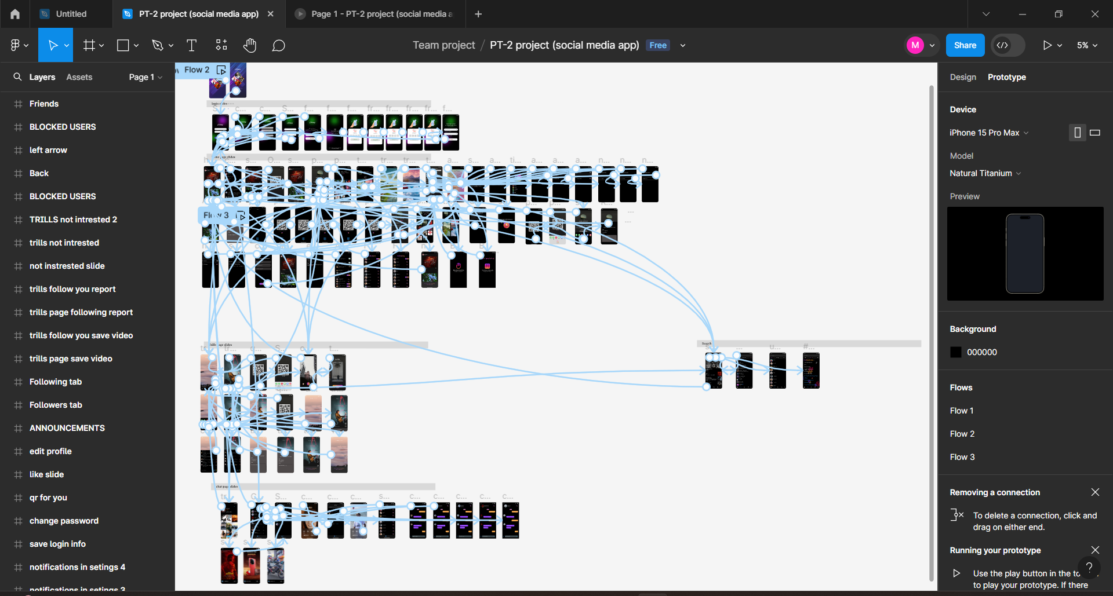
PROTOTYPE

Slide 14
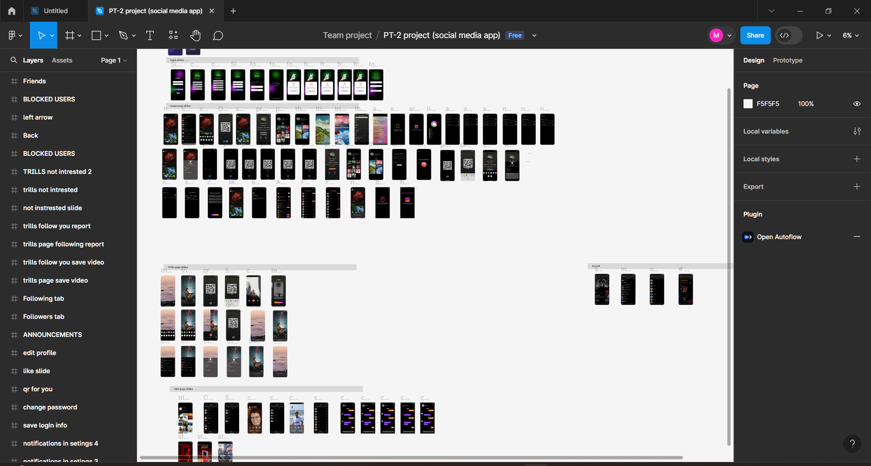
DESIGN SLIDES

Slide 15
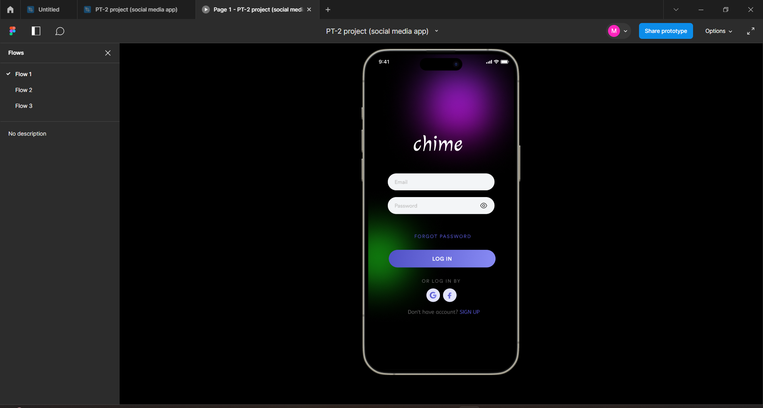
LOGIN SLIDE

Slide 16
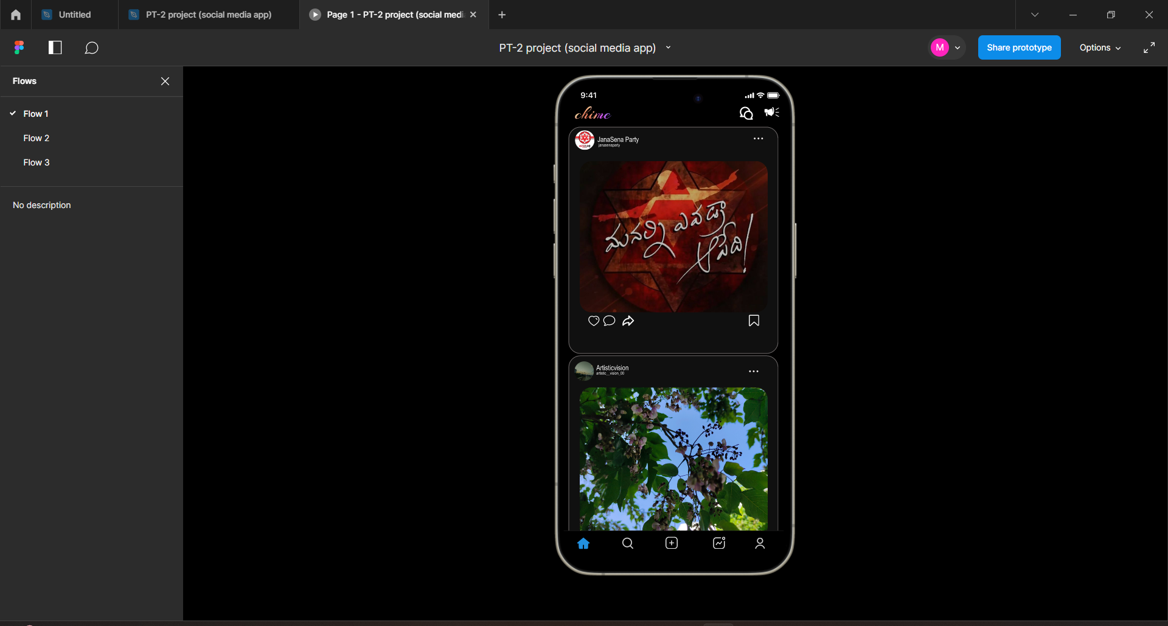
HOME PAGE SLIDE

Slide 17
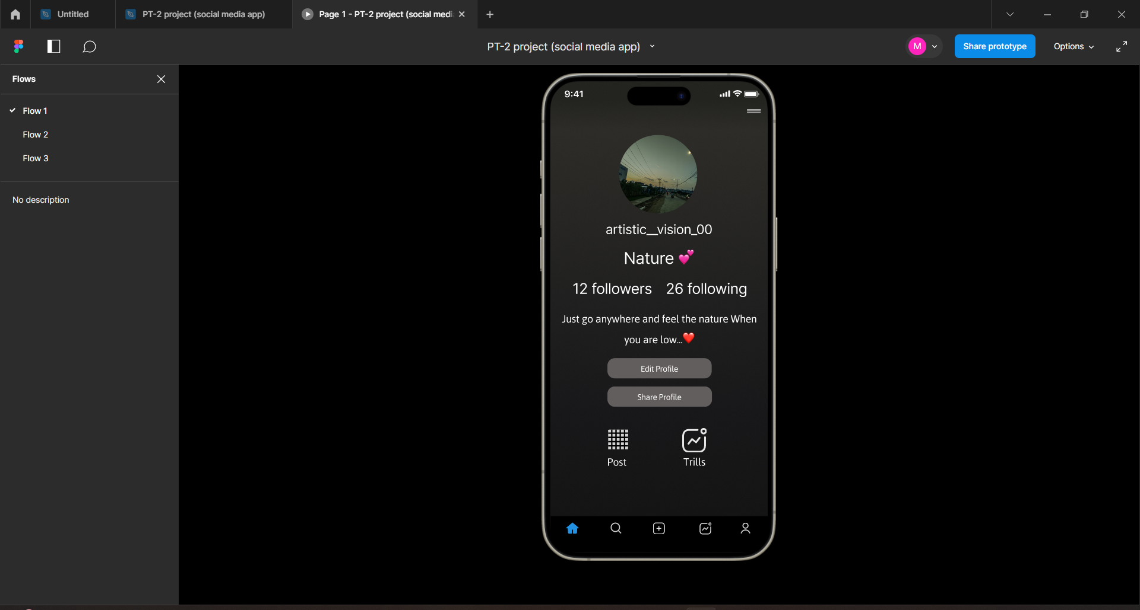
PROFILE SLIDE

Slide 18
Conclusion
Figma redefines UI/UX design for social media mobile apps with its suite of powerful tools and features. Its cloud-based platform seamlessly connects designers, enabling real-time collaboration and efficient version control.
Design teams working on intricate projects find Figma to be an indispensable tool. With Figma, designers can effortlessly streamline their workflow, allowing for quick iterations and enhancements. It fosters a collaborative environment where ideas can be shared, discussed, and incorporated seamlessly, resulting in designs that truly align with user needs and expectations.
Beyond collaboration, Figma offers an intuitive interface that minimizes the learning curve, making it accessible to both seasoned designers and beginners alike. Its wide array of features empowers designers to create visually captivating and user-centric designs.
The component library feature in Figma facilitates the creation and reuse of consistent UI elements, ensuring brand cohesion and reducing design time. Its prototyping capabilities allow designers to create interactive prototypes, enabling stakeholders to experience the design in action and provide valuable feedback.
Moreover, Figma's integration with other design tools and platforms enhances its versatility. Designers can seamlessly import assets, fonts, and color palettes from external sources, further streamlining the design process. Overall, Figma revolutionizes the UI/UX design process for social media mobile apps.

Slide 19
References
Figma for Beginners: A Hands-On Guide to Learning Figma's Features and Workflows by Stephen Coles.
UI/UX Design for Beginners: Learn the Essentials of User Experience Design by Smita Malik.
The Design of Everyday Things by Donald Norman.
Figma: https://www.figma.com/ offers a free plan that includes a ton of features to get you started. Figma also has a great community of designers who share resources and tutorials.
Introduction to Figma - A Beginner's Tutorial (2023 UI/UX Design) [YouTube]: Figma For Beginners: Explore ideas (1/4)
This YouTube tutorial is a great introduction to Figma for beginners. It covers the basics of the Figma interface, as well as how to create wireframes, mockups, and prototypes.
The Ultimate Guide to Figma by UXCollective https://start.uxdesign.cc/ : This website offers a comprehensive guide to Figma, including tutorials, tips, and tricks.

Slide 20
Thank You

